Slide 1


Title Slide
Identifying Transformative PILGRIMAGE PATTERNS:
The Evolution of Religious Tourists Demographics at the BASILICA OF BOM JESUS, GOA, INDIA
SWIZEL R. MONTEIRO, 23P0630014, GOA UNIVERSITY
DISSERTATION GUIDE:
JARRET S.A. FERNANDES, GOA UNIVERSITY
DISSERTATION COGUIDE:
VINAYAK NAIK, BITS PILANI, GOA

Slide 2
CONTENTS
Title Slide
Introduction
Objectives
Literature Review
Methodology
Data Description
Analysis & Results
Discussion
Conclusion
Future Work
Acknowledgements
References

Slide 3
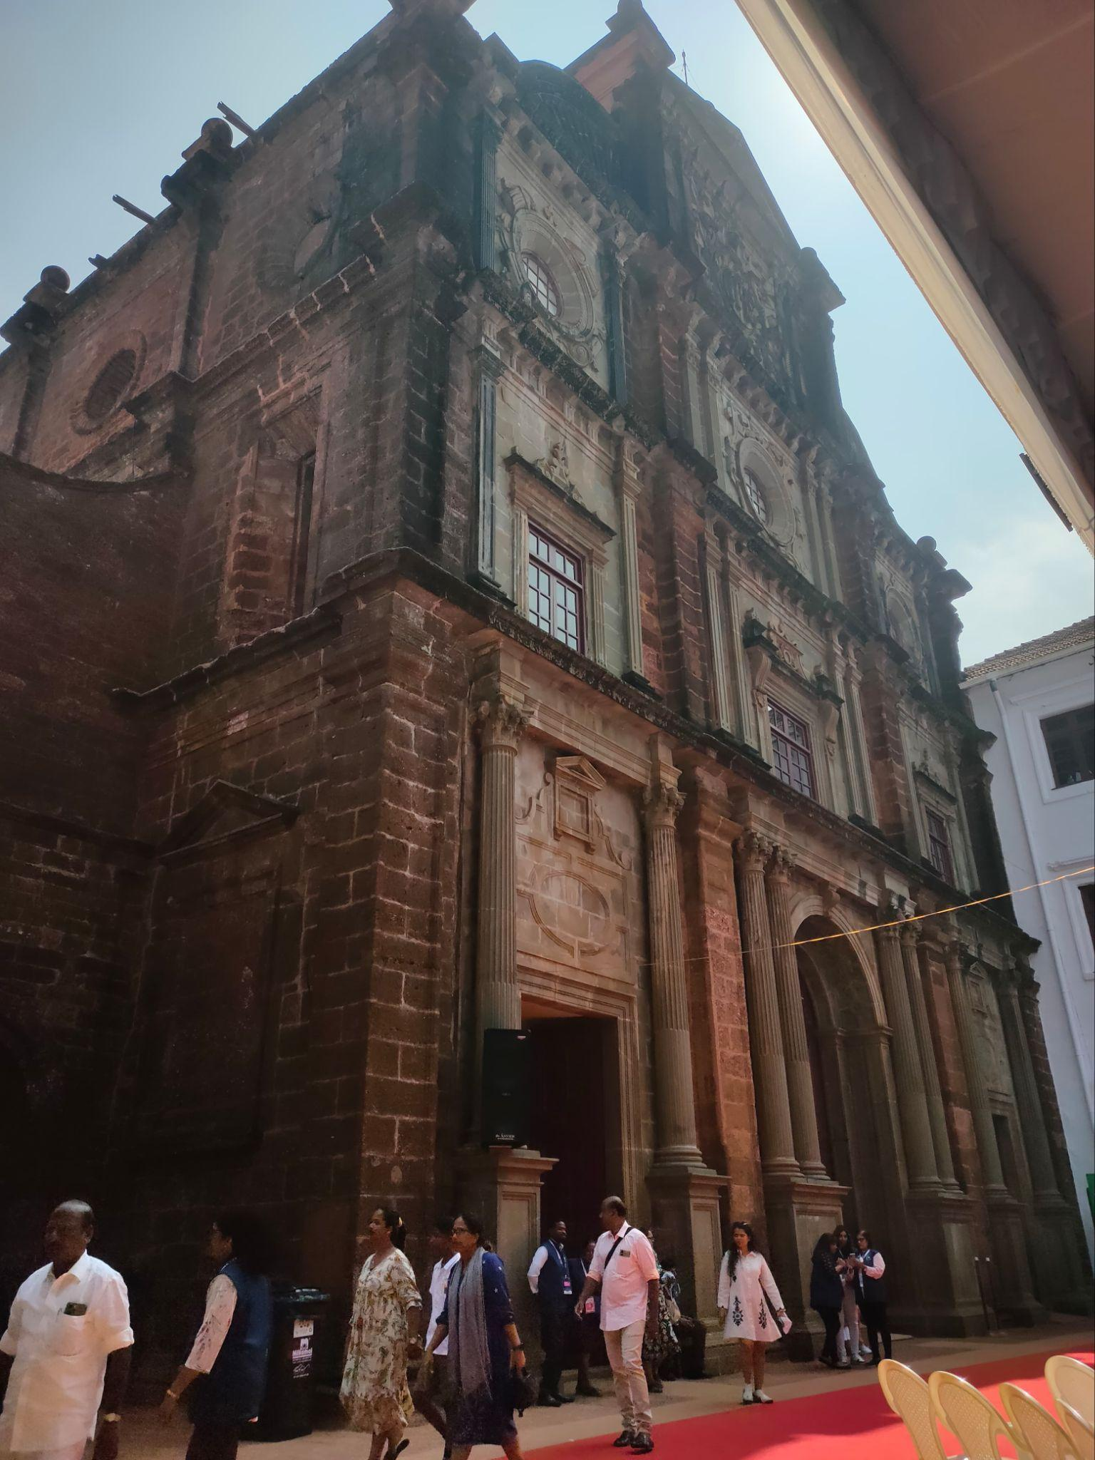

Introduction
Problem Statement: To get data-driven insights into evolving visitor patterns during the 18th Exposition of the Sacred relics of St. Francis Xavier at the Basilica.
Motivation: The 18th Exposition attracted millions, understanding visitor behavior is vital for planning, management, and enhancing religious tourism.
Notes:
Religious tourism blends spirituality, culture, and heritage. The UNESCO World Heritage Site, the Basilica, preserving the sacred relics of St. Francis Xavier has long been a beacon for religious tourism, attracting a diverse range of pilgrims and visitors.

Slide 4




Objectives
DEMOGRAPHIC ANALYSIS OF VISITORS
IMPACT OF ONLINE ENGAGEMENT POST-PANDEMIC
CONTRIBUTION OF EXPOSITION TO THE TOURISM SURGE
PREDICT EVENT PARTICIPATION
To analyze demographic and behavioral factors (age, gender, region, motivation) that influence pilgrimage participation and repeat visitation at the Basilica of Bom Jesus.
To study how online religious services have shape travel decisions in the post-pandemic era.
To assess whether the 2024 Exposition had really contributed to the observed surge in tourist arrivals in Goa
To predict visitor event participation based on visitor demographics.

Slide 5
RESEARCH QUESTIONS and HYPOTHESIS
What are the primary factors influencing pilgrimage participation at the Basilica of Bom Jesus?
Demographic factors (age, gender, region) significantly influence the likelihood of participating in the Exposition.
What factors influence repeat pilgrimages to the Basilica?
First time visitors have different engagement motivations compared to long time devotees and frequent pilgrims.
How has COVID-19 pandemic transformed pilgrimage patterns at the 18th Exposition held at the Basilica?
What role do YouTube and other platforms play in shaping travel decisions and pilgrim behavior?
Can the surge in Goa’s tourist arrivals in 2024 be statistically linked to the 18th Exposition?
The Exposition had no significant effect on the total number of tourist arrivals in 2024 compared to previous years
Can machine learning models effectively predict visitor event participation based on survey data.

Slide 6
Literature Review
Religious Tourism versus Secular Pilgrimage: The Basilica of La Sagrada Família.
Religious tourism bridges spirituality and cultural exploration, evolving from traditional pilgrimages to modern cultural heritage experiences.(Marine-Roig, 2015)
Exposition of St. Francis Xavier’s Holy Relics in Goa: An Importance-Performance Analysis
I-P Analysis revealed significant improvements were required in infrastructure and visitor satisfaction. A motivational analysis revealed no major demographic differences between purely religious pilgrims and those with mixed motivations, except for age-related factors.(Pillai, et al.)
Segmentation by motivations in religious tourism: A study of the Christ of Miracles Pilgrimage, Peru.
This study identified five motivational dimensions and three visitor segments, highlighting that the "Religious" group showed the highest satisfaction and loyalty. The research emphasizes segment-based strategies ,stakeholder collaboration and infrastructure enhancement in religious tourism.(Carvache-Franco, et al.)

Slide 7
Literature Review
Religious tourism and the new evangelization: theory and best practice in the pastoral promotion of the Church’s cultural heritage
The Catholic Church has embraced art, architecture, and hospitality to engage diverse audiences. Here, it demonstrates how religious sites and events can shape both faith-based and secular tourism.(Tan, 2018)
Reflecting on the Impact of COVID-19 on Religious Tourism and Pilgrimage
The COVID-19 pandemic accelerated the shift to online spiritual services, reshaping religious tourism for the modern era.(Raj & Griffin, 2020)
Religious Events And Event Management: An Opportunity for Local Tourism Development
The research emphasized on the importance of effective event management in enhancing the cultural and economic value of religious tourism.(Cerutti & Piva, 2015)

Slide 8

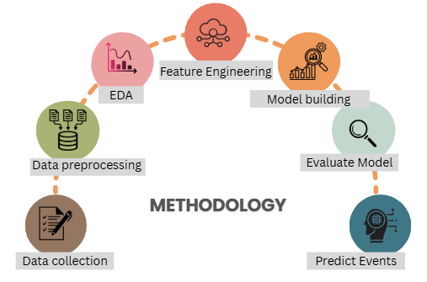
Methodology
ETHICAL CONSIDERATIONS
EVENT
Informed Consent: Participation was voluntary and anonymous.
Ethical Approval: Conducted in compliance with research standards.
Conducted during the 18th Exposition of the Sacred Relics of St. Francis Xavier(Pillai et al., 2014)
Duration: 21st November – 3rd December
The event attracts millions of pilgrims from across India and the world
APPROACH
Mixed-Methods Research (Quantitative)
Structured Questionnaire: Stratified sampling (2164 responses)
Attendance records, Overnight Pilgrim Checkins, Digital engagement metrics, Tourism Statistics in Goa, Walking Pilgrims(Qualititative)

Slide 9
Software Tools and Libraries used
Python (3.x) | Core programming language
pandas | Data preprocessing and manipulation
scikit-learn MultiOutputClassifier OneVsRestClassifier RandomForestClassifier, GradientBoostingClassifier, DecisionTree Classifier, Logistic Regression, kNN, SVC,GradientBoostingClassifier | Machine learning models and utilities
LabelEncoder, StandardScaler | Feature encoding and scaling
joblib | Saving/loading trained models and encoders
Streamlit | Deploying interactive web-based prediction interface
matplotlib.pyplot / seaborn Power BI | Data visualization

Slide 10
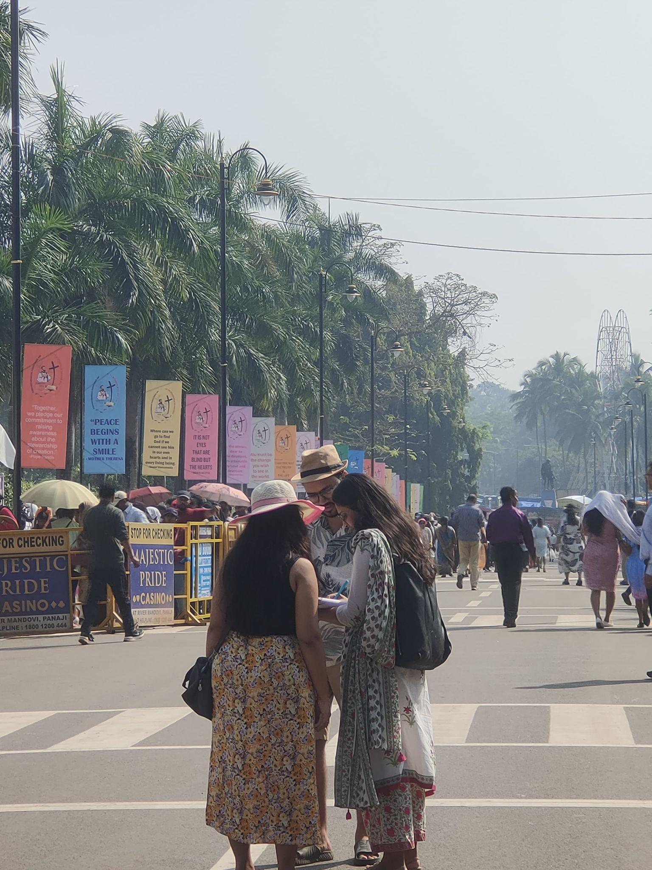
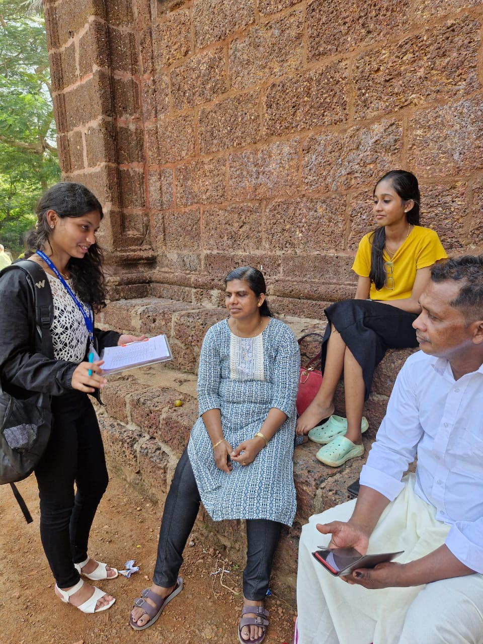
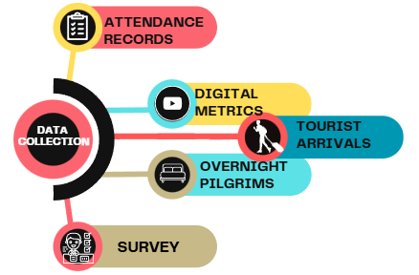
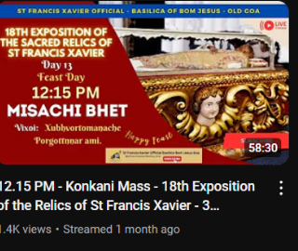
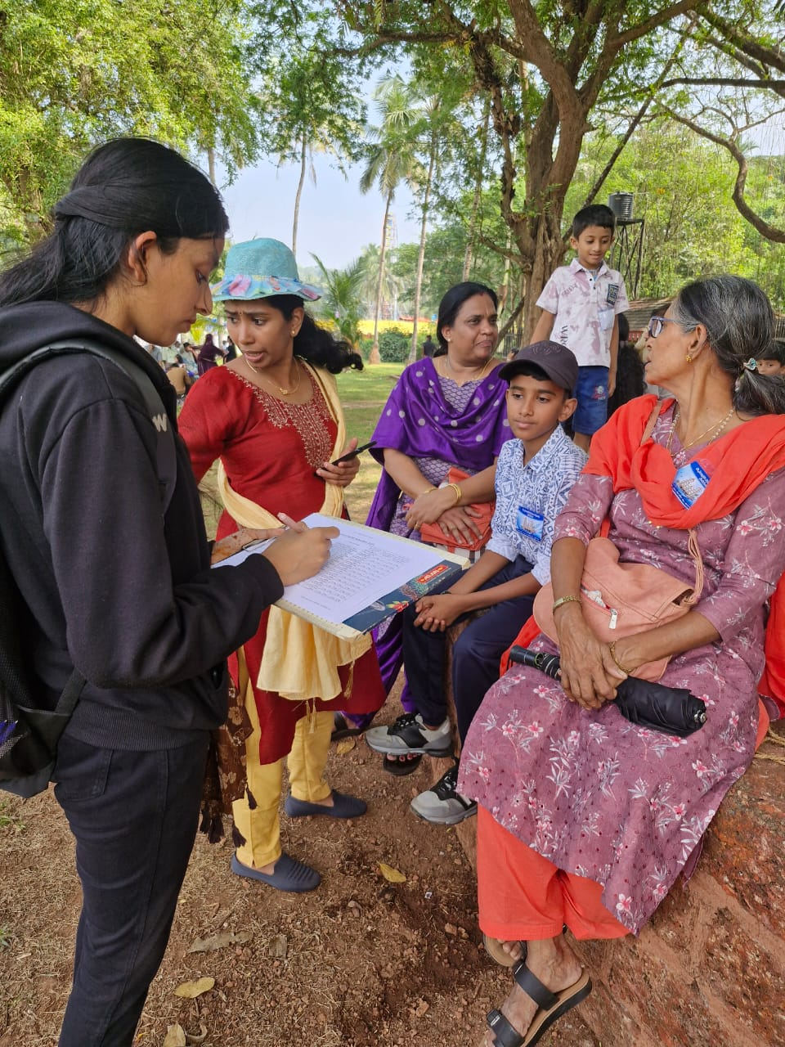
Data Collection
ATTENDANCE RECORDS
Daily attendee counts across key points for turnout analysis.
Source: St. Francis Xavier Exposition Committee
DIGITAL METRICS
YouTube live-streamed Mass views during Novena days to assess virtual participation.
Source: St. Francis Xavier Exposition Committee
TOURIST ARRIVALS
Local/ International tourist arrivals to Goa
Source: Tourism Department
OVERNIGHT PILGRIMS
Analysis of daily check-ins: Camping guests,Walking pilgrims
Source: St. Francis Xavier Exposition Committee
SURVEY
Structured survey targeting demographics, and motivations, In-person at the Basilica and camps. Online distribution using QR codes for wide reach.

Slide 11
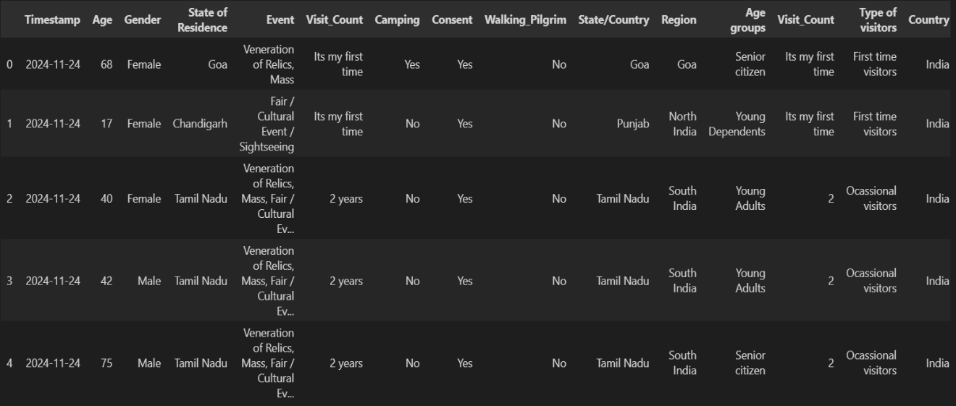
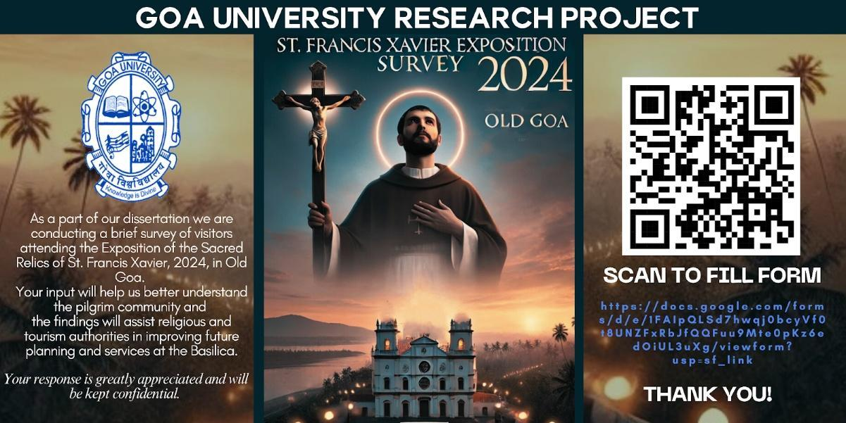
Poster created for Data Collection and Data set

Slide 12

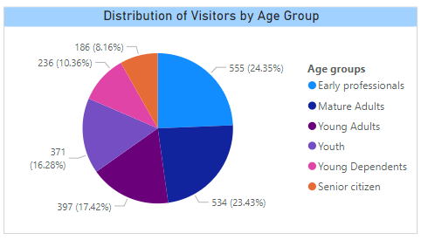
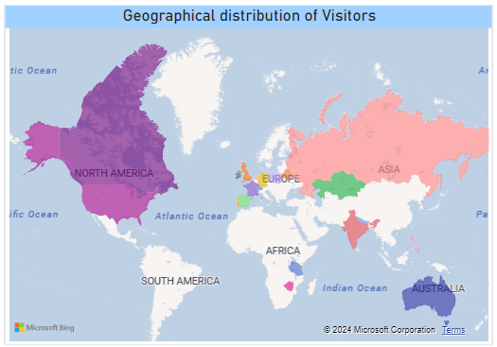
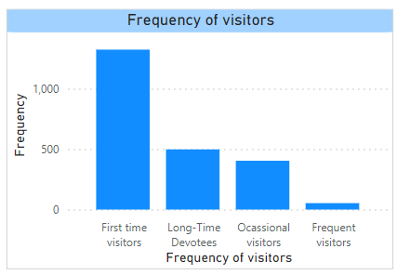
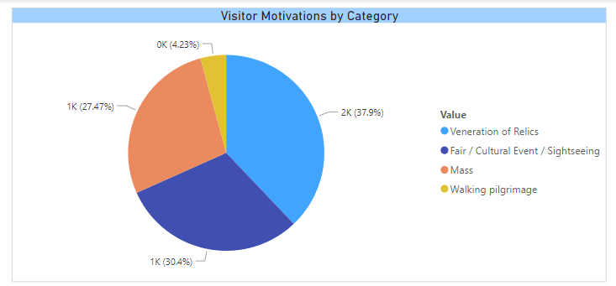
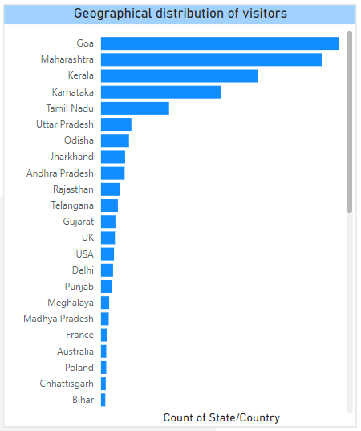
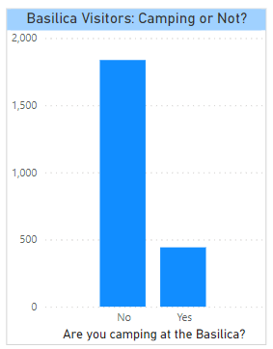
Survey Analysis

Slide 13
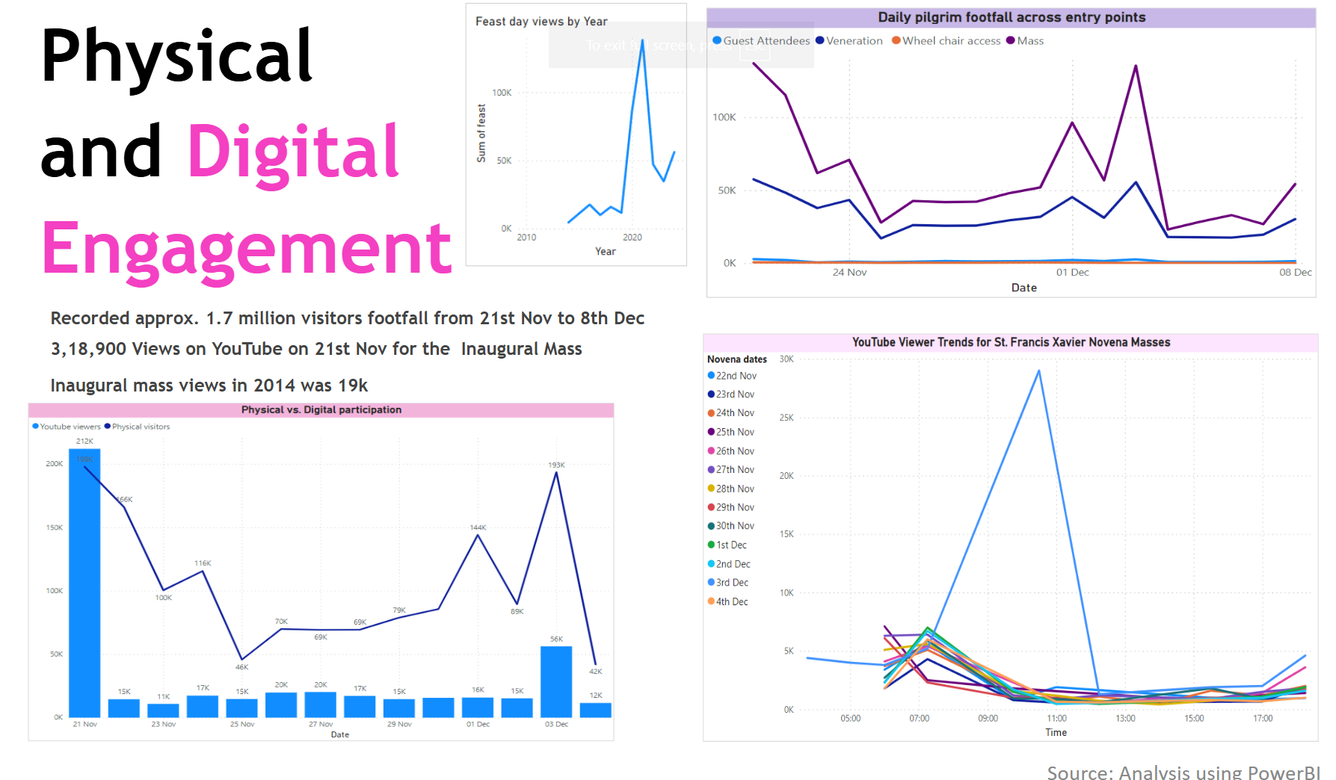

Slide 14
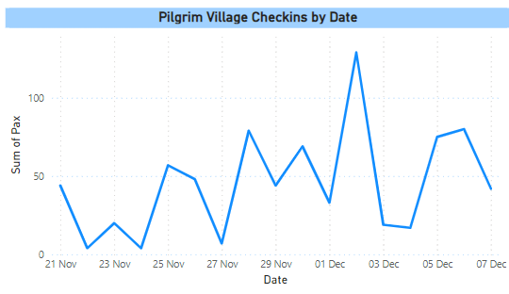
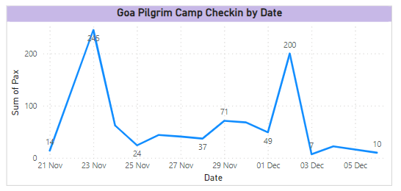
Overnight
Pilgrim
Check-ins
Pilgrim Village - Barracks for Indian pilgrims during their stay at the Basilica of Bom Jesus.
Goa Pilgrim Tents – Accommodation for Goan Pilgrims
Walking Pilgrim Tents – Shelter for Pilgrims who travelled on foot from various parts of India, including Maharashtra and Karnataka.Covered 130-140 kilometers for over 2-4 days
!st walked to Old Goa in 1974, 7 pax,
Walking Pilgrims
1200 approx | 2nd Dec

Slide 15
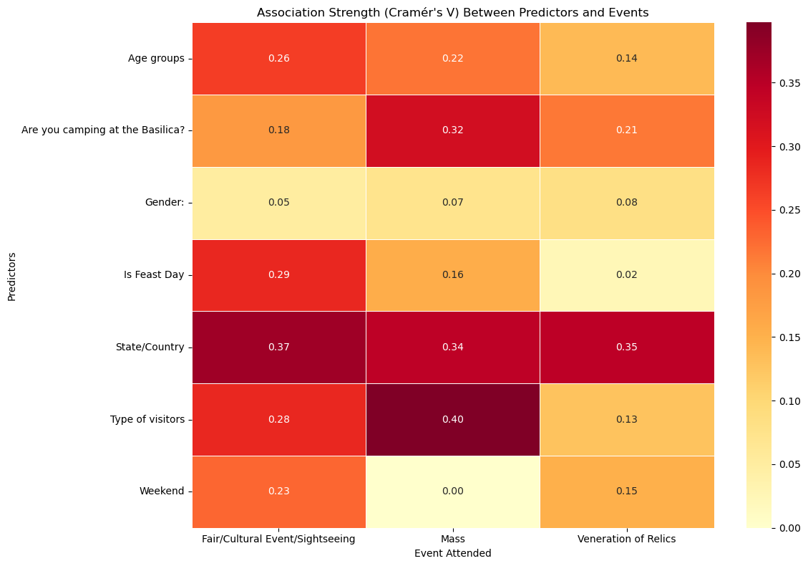
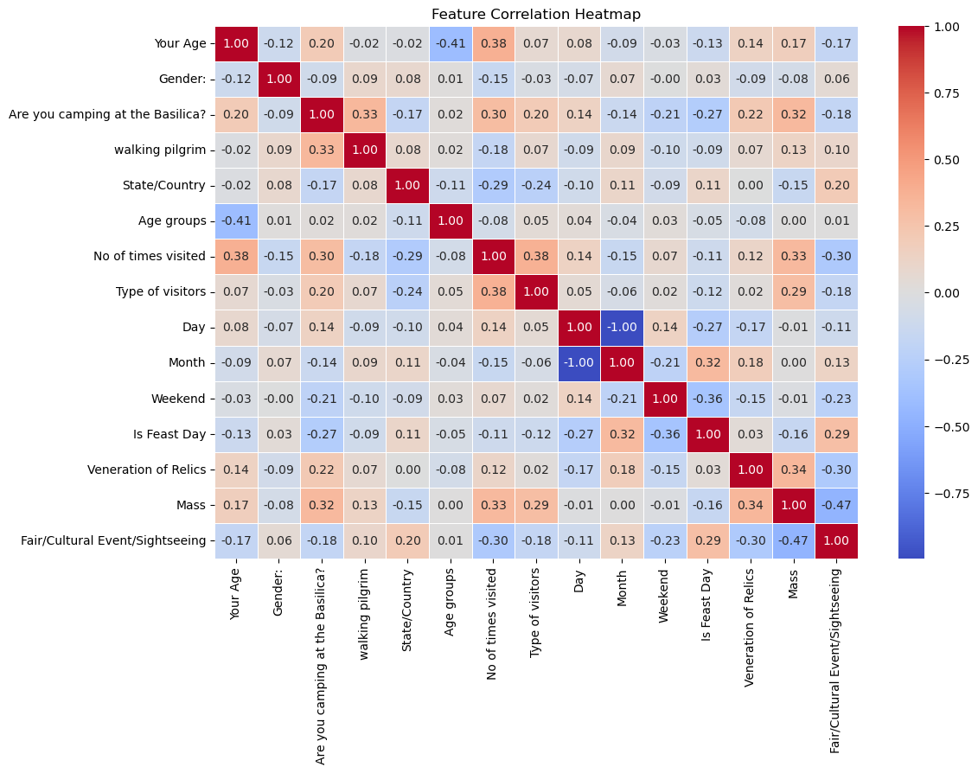
Data Preprocessing
Survey responses (~2200) were cleaned using Excel and Python and missing values were handled
Categorical variables encoded. (Label Encoder)
New features like age groups and visitor types were engineered for deeper analysis.
Target Variable
Multi-label classification was used to predict event participation (e.g., Mass, Relics Veneration, Fair).
Events were binarized using multi-label binarization for model compatibility.
Feature Associations
Numerical Analysis: Pearson/Spearman correlation used; heatmaps visualized relationships.
Categorical Analysis: Chi-Square tests and Cramér’s V assessed significance and effect size.
Hypothesis Testing: Validated feature-event associations using statistical methods.
Feature Engineering
Selected key predictors: Age Group, Gender, Origin, Visitor Type, Camping Status, Weekend, Feast Day.
Features chosen based on statistical strength (Cramér’s V > 0.1) and domain knowledge to enhance model accuracy.

Slide 16
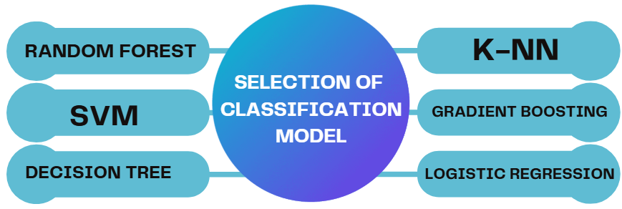
Model Selection & Setup
Models considered for classification are the following→
All are implemented using MultiOutputClassifier/ One-vs-Rest strategies(scikit learn)
Accomplishments to Date
Training Setup:
Dataset split: 70% training, 30% testing
Software Tools and Libraries used
Python (3.x) | Core programming language
pandas | Data preprocessing and manipulation
LabelEncoder StandardScaler | Feature encoding and scaling
joblib | Saving/loading trained models and encoders
Streamlit | Deploying interactive web-based prediction interface
matplotlib.pyplot / seaborn Power BI | Data visualization
Evaluation & Testing
Evaluation Metrics:
Accuracy, Precision, Recall, F1-Score (Macro & Sample Average)
Hamming Loss (Lower is better), Jaccard Score (Higher is better)
F1-Score Importance: Balances Precision & Recall and hence is more reliable than Accuracy for multi-label tasks
Testing Results:
Evaluated on hold-out test set

Slide 17
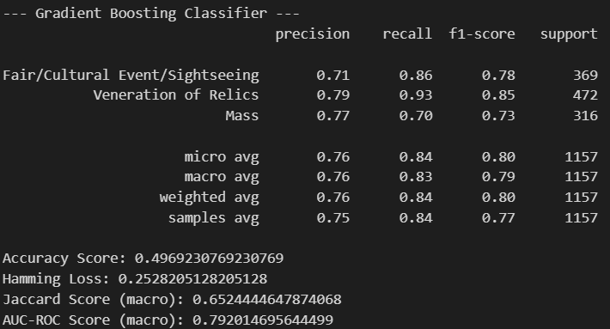
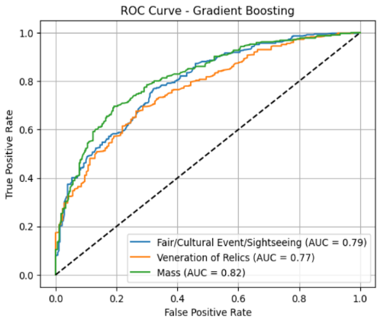
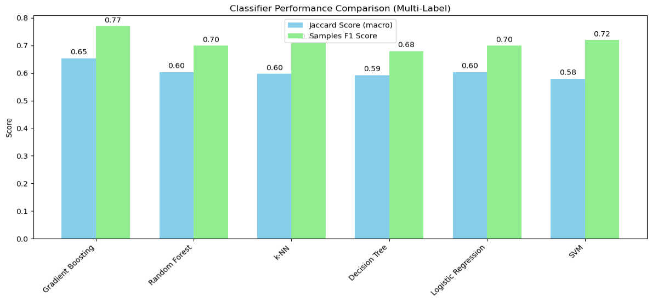
Model Evaluation Results
Gradient Boosting – Best Performing Model!
Accuracy: 49.7% F1 Score: 0.77 Jaccard Score: 0.65 Hamming Loss: 0.25 (lower is better) High recall for Veneration of Relics (0.93), Mass AUC: 0.82 Balanced, consistent predictions with fewer label-wise errors
D
MODEL COMPARISON
Gradient Boosting: Best overall model. It is accurate, precise, and low error
Random Forest: Strong baseline model
KNN: Works well when visitor patterns are similar
Decision Tree: Interpretable but less robust
SVM & Logistic Regression: Good recall for specific classes, but limited general performance
Notes:
Random ferest-reduces variance and enhances its ability to capture complex, non-linear relationships across the feature space
Logistic Regression-faces challenges in capturing intricate, non-linear dependencies among features, which needs to be considered when selecting models for complex datasets.
Support Vector Machines aims to find the optimal separating hyperplane that maximizes the margin between the classes. In multi-label scenarios, the One-vs-Rest approach is utilized to extend SVM capabilities across all the target outputs by training one classifier per class.
The k-NN algorithm takes the majority vote of the k closest examples in the feature space to make predictions.
The Gradient Boosting Classifier is an ensemble technique that sequentially combines weak learners, typically decision trees, to minimize a differentiable loss function. This model iteratively focuses on the errors of the previous learners, refining its predictions with each successive tree.

Slide 18
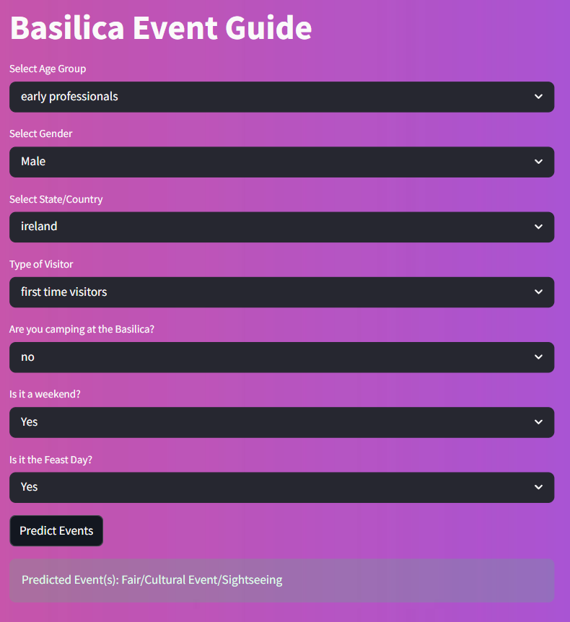
Interactive Prediction Tool
Built with Streamlit
Inputs: Age, gender, visitor type, weekend/feast day
Output: Predicted events –
Mass, Veneration, Fair/Cultural Event/ Sightseeing
Model used is Gradient Boosting and label encoders (joblib)
Applications:
Forecasts visitor interests
Enables personalized suggestions
Helps in crowd and event planning

Slide 19

Future Work
Real-Time Attendance Tracking Implementing daily footfall monitoring at the Basilica can provide granular insights into tourist behavior and event-specific engagement.
Post-Exposition Analysis With no Exposition in the coming year, comparing tourism data will help isolate and quantify the event’s true economic impact on Goa's tourism sector.
Model Deployment for Stakeholders Deploy the predictive model as a decision-support tool for church authorities, tourism departments, and event planners to enable data-driven religious tourism management.

Slide 20
DISCUSSIONS
Influence of Demographics (RQ1 / H1)
Interpretations: Age Groups: Older pilgrims favored rituals (Mass, Relics); younger attendees preferred cultural events. Gender: Females leaned towards religious events; males preferred cultural programs. Region: Participation patterns varied across states and countries.
Key Insights: Chi-square tests confirmed significant associations between demographics and event participation..
Pilgrimage Shifts Post-COVID (RQ3 & RQ4)
Virtual Pilgrimage: YouTube viewership spiked in 2020–21 (peak: 138,000+ in 2021) when there was complete lockdown in Goa. 2024 Revival: Over 7 million in-person attendees for the 18th Exposition this year. YouTube Impact: 212,000+ views for 2024 inaugural mass and multilingual Masses drew a global audience.
Digital media fostered hybrid participation and wider outreach post-covid.
Visitor Type & Participation (RQ2 / H2)
First-Time Visitors: Engaged more in sightseeing and cultural events. Repeat Visitors: Strong spiritual focus with higher attendance at Mass and relic veneration
Supports need for visitor-type-specific strategies in religious tourism.

Slide 21
DISCUSSIONS
RQ5 / H3 — The 2024 Exposition’s Impact on Goa’s Tourism
Record Tourism: Goa received over 10.4 million visitors in 2024, the highest ever. Exposition Influence: Over 7 million pilgrims attended during November to December. Statistical Outcome: Rejects H3 (no effect on tourism) – significant positive impact confirmed.
The Exposition was a major driver of Goa’s post-COVID tourism revival.
RQ6 — Predictive Modeling of Pilgrimage Participation
Supervised machine learning applied to predict multi-event attendance. Best Model: Gradient Boosting Classifier. Top Predictive Features (based on Cramér’s V and Chi-square): Type of Visitor State/Country Camping at Basilica Model Usefulness: High interpretability andF1 Score Supports real-world applications in event planning, crowd prediction, and targeted communication.
ML provides actionable insights into pilgrim behavior for smarter religious tourism management.
Pilgrimage is now both physical and digital – rooted in tradition, expanded by tech.

Slide 22
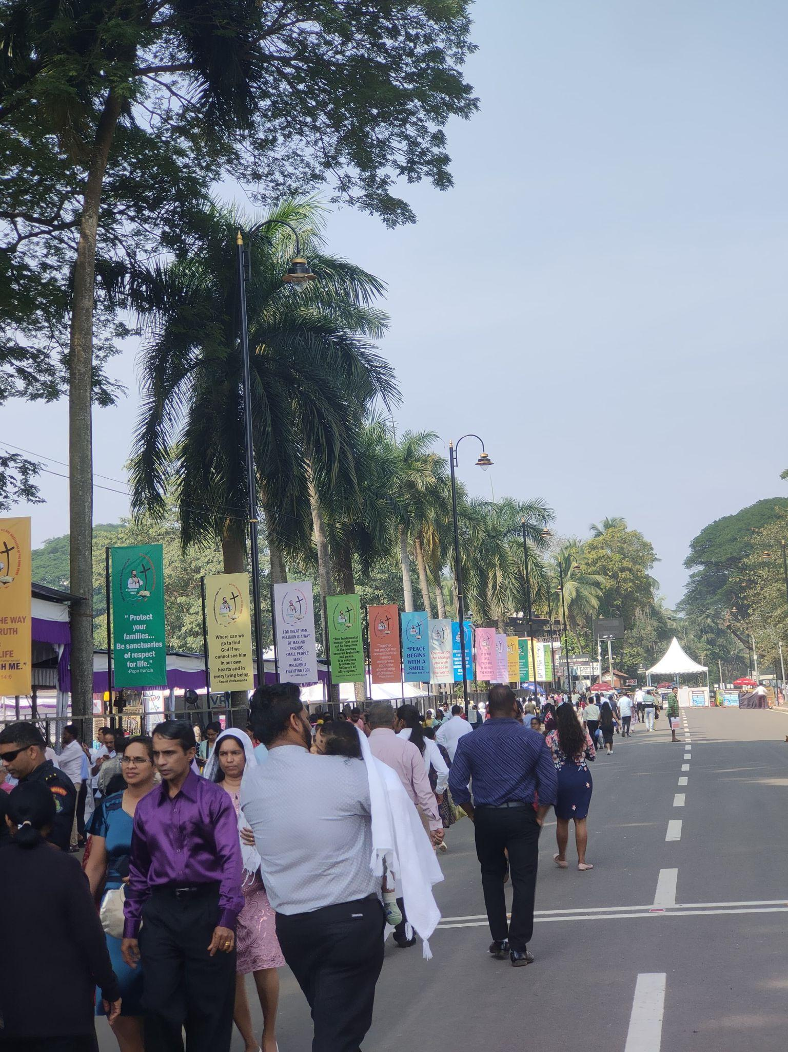
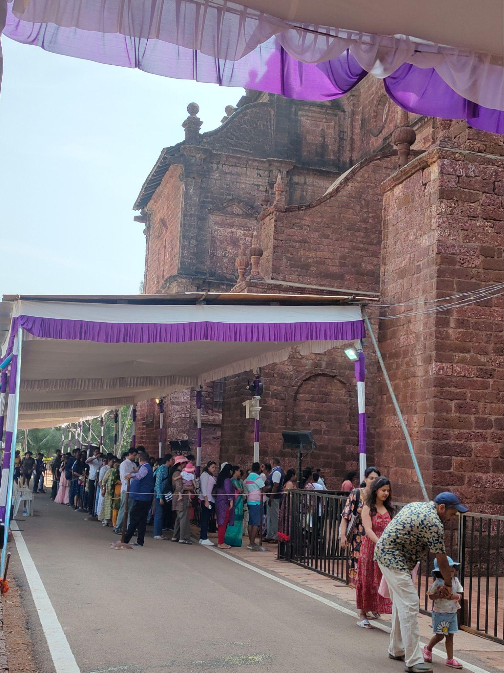
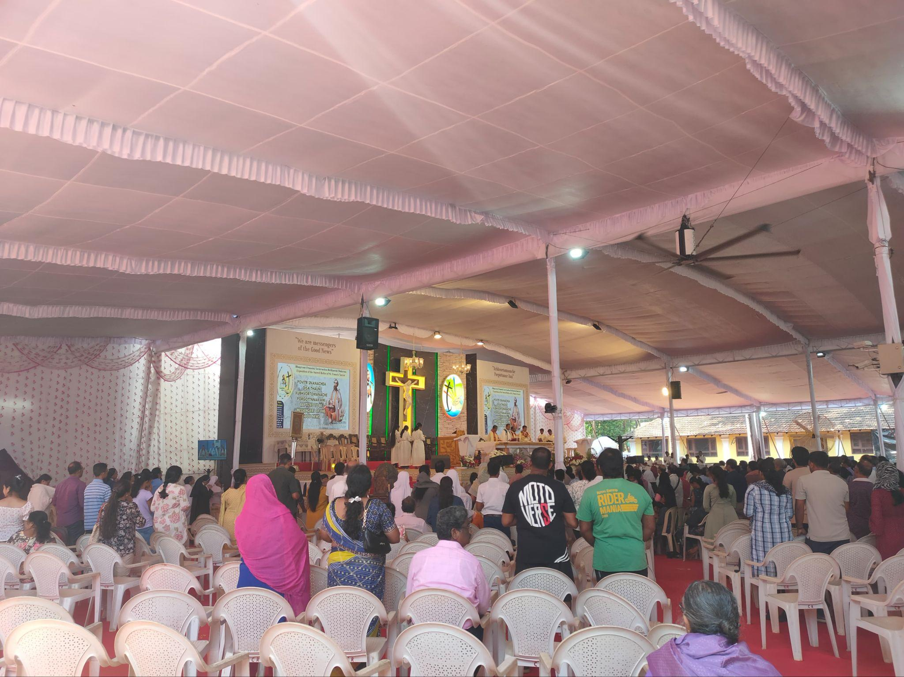
CONCLUSION
Holistic Pilgrimage Insights
Evolving Pilgrimage Landscape
The Basilica’s Role
Actionable Recommendations
A Living Tradition, Informed by Data
This study offers a data-driven analysis of the 18th Exposition, blending survey responses, digital metrics, and machine learning to understand modern pilgrimage behaviors.
Pilgrimage now spans both physical presence and digital engagement, revealing cross-generational participation and culturally diverse motivations.
The Basilica of Bom Jesus exemplifies how heritage sites can preserve sacredness while embracing innovation and fostering global spiritual connectivity.
Predictive modeling and visitor segmentation enable tailored planning, enhanced infrastructure, and greater inclusivity guiding future religious tourism initiatives.
The dissertation redefines pilgrimage as a tradition grounded in faith, enriched by culture, and empowered through technology and data.
Notes:
This study offers a data-driven analysis of the 18th Exposition, blending survey responses, digital metrics, and machine learning to understand modern pilgrimage behaviors.
Pilgrimage now spans both physical presence and digital engagement, revealing cross-generational participation and culturally diverse motivations.
The Basilica of Bom Jesus exemplifies how heritage sites can preserve sacredness while embracing innovation and fostering global spiritual connectivity.
Predictive modeling and visitor segmentation enable tailored planning, enhanced infrastructure, and greater inclusivity—guiding future religious tourism initiatives.
The dissertation redefines pilgrimage as a tradition grounded in faith, enriched by culture, and empowered through technology and data.

Slide 23
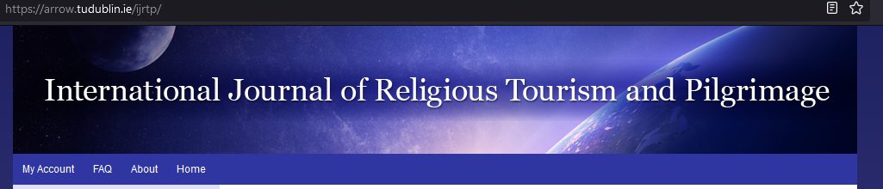
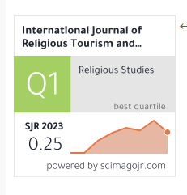
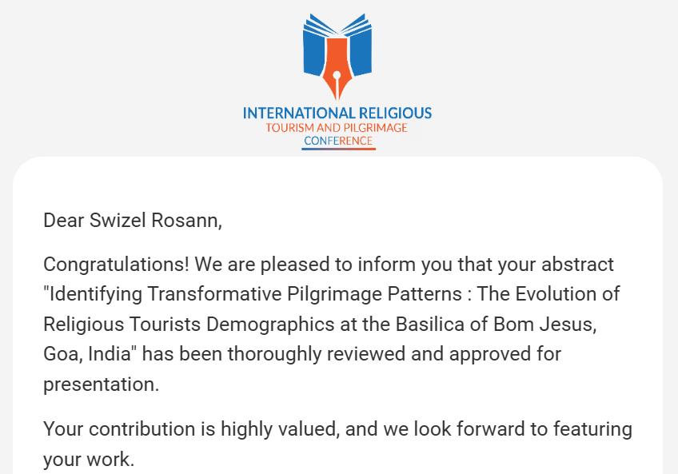
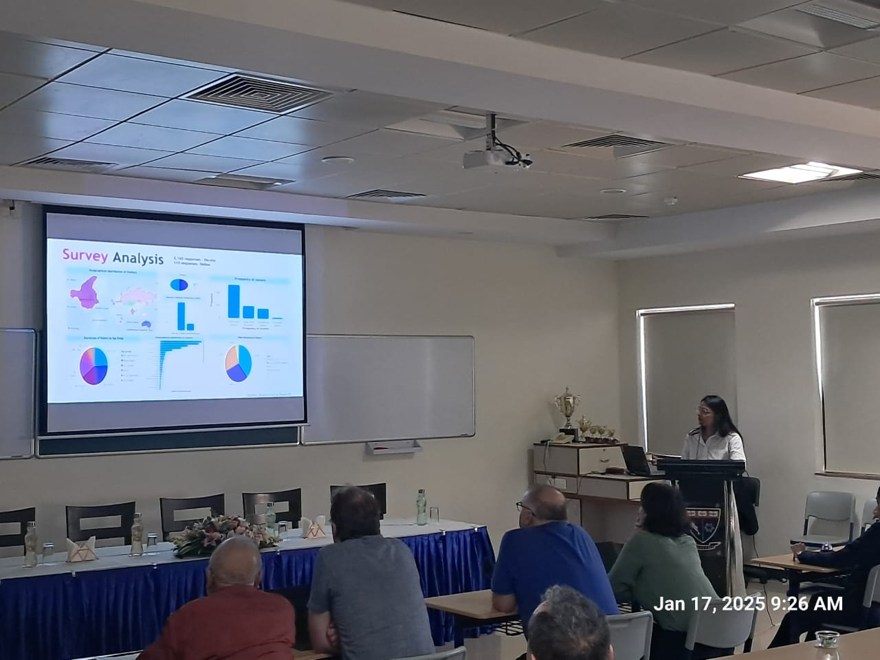
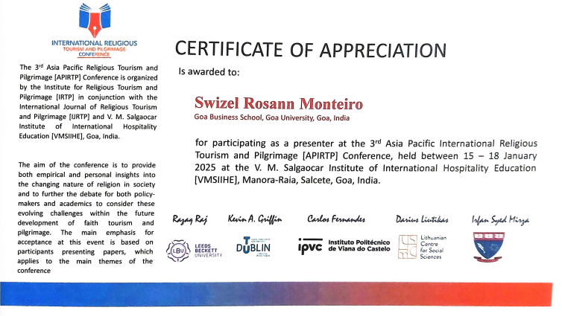
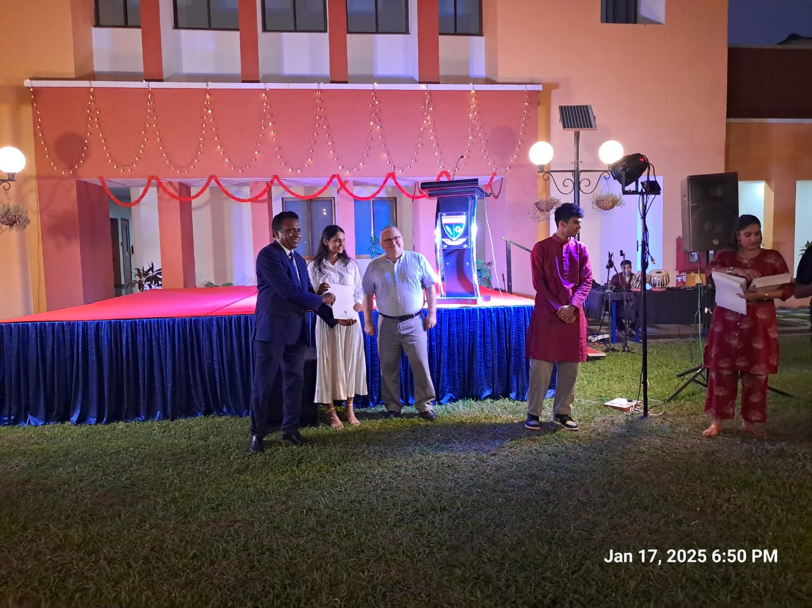
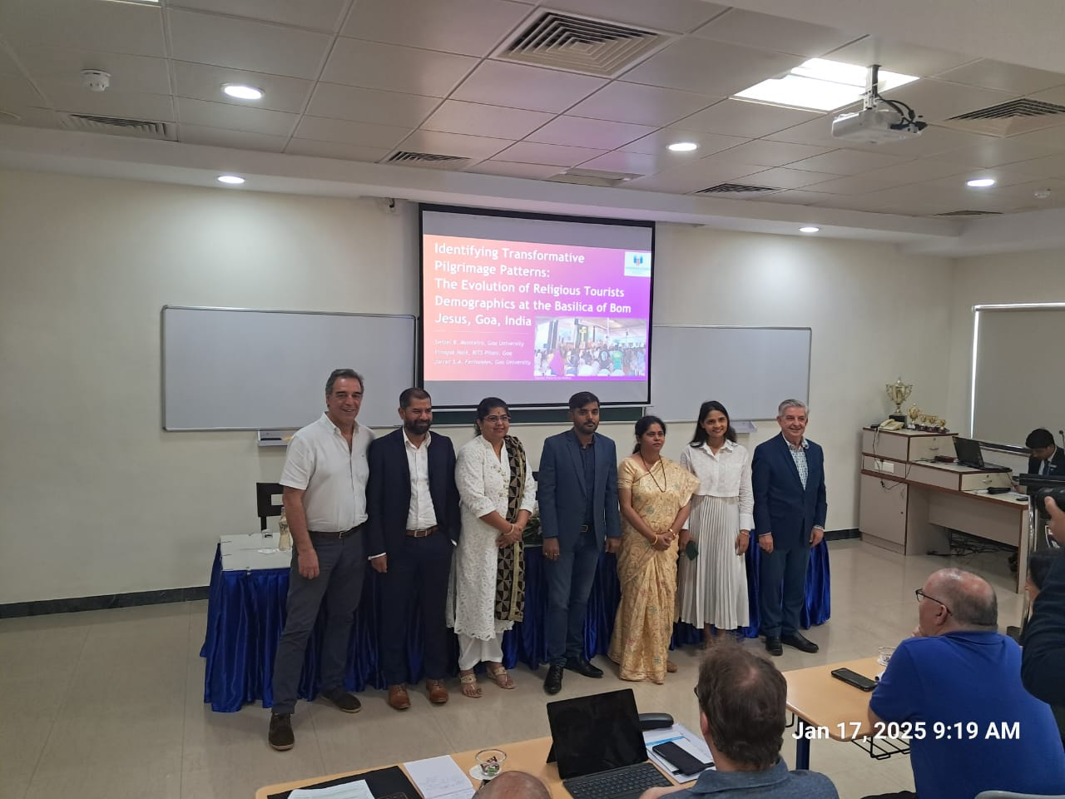
APIRTP
CONFERENCE
Presentation and Publication Opportunity

Slide 24
THANK YOU!

Slide 25

References
Tan, J. (2018). Religious tourism and the new evangelization: theory and best practice in the pastoral promotion of the Church’s cultural heritage. Church, Communication and Culture, 3(3), 283–309.
Kizhakanveatil Bhaskaran Pillai, S., Kamat, K., Scaglione, M., Pillai, B., & Kizhakanveatil, S. (2017). Exposition of St. Francis Xavier’s Holy Relics in Goa: An Importance-Performance Analysis. International Journal of Religious Tourism and Pilgrimage, 5(1), 7.
Raj, R., & Griffin, K. A. (2020). Reflecting on the Impact of COVID-19 on Religious Tourism and Pilgrimage. International Journal of Religious Tourism and Pilgrimage, 8(7)
Carvache-Franco M, Regalado-Pezúa O, Carvache-Franco O, Carvache-Franco W (2024) Segmentation by motivations in religious tourism: A study of the Christ of Miracles Pilgrimage, Peru. PLOS ONE 19(5): e0303762. https://doi.org/10.1371/journal.pone.0303762
Cerutti, S., & Piva, E. (2015). Religious tourism and event management: An opportunity for local tourism development. international journal of religious tourism and pilgrimage, 3(1), 8.

